Slide 1

My Linear Relationships Interactive Notebook
Name
Class
Term 3 Semester 2

Slide 2
Contents
Formula Page
Page
Date
Description
2
3

Slide 3
Tasks
24
7
30
Essential Question
Questions
Notes
Summary
10
11

Slide 4
24
7
30
Date
Drawing Linear Graphs 2
EQ – How do you draw a graph using the $x and y$intercepts?
The x-intercept is the point where the line crosses the x-axis.
The y-intercept is the point where the line crosses the y-axis.
13

Slide 5
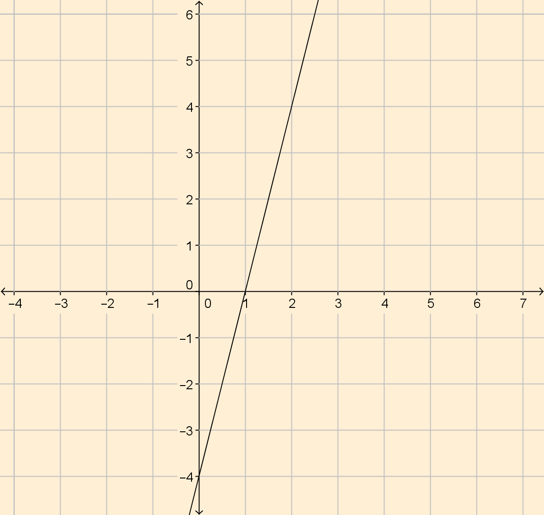
24
7
30
Date
Drawing Linear Graphs 2
EQ – How do you draw a graph using the $x and y$intercepts?
The x-intercept is the point where the line crosses the x-axis.
The y-intercept is the point where the line crosses the y-axis.
13

Slide 6
24
7
30
Date
Drawing Linear Graphs 2
EQ – How do you draw a graph using the $x and y$intercepts?
The x-intercept is the point where the line crosses the x-axis.
The y-intercept is the point where the line crosses the y-axis.
13

Slide 7
24
7
30
Date
Drawing Linear Graphs 2
EQ – How do you draw a graph using the $x and y$intercepts?
The x-intercept is the point where the line crosses the x-axis.
Crosses at 1
The point (1,0)
The y-intercept is the point where the line crosses the y-axis.
13

Slide 8
24
7
30
Date
Drawing Linear Graphs 2
EQ – How do you draw a graph using the $x and y$intercepts?
The x-intercept is the point where the line crosses the x-axis.
Crosses at 1
The point (1,0)
The y-intercept is the point where the line crosses the y-axis.
Crosses at -4
The point (0,-4)
13

Slide 9
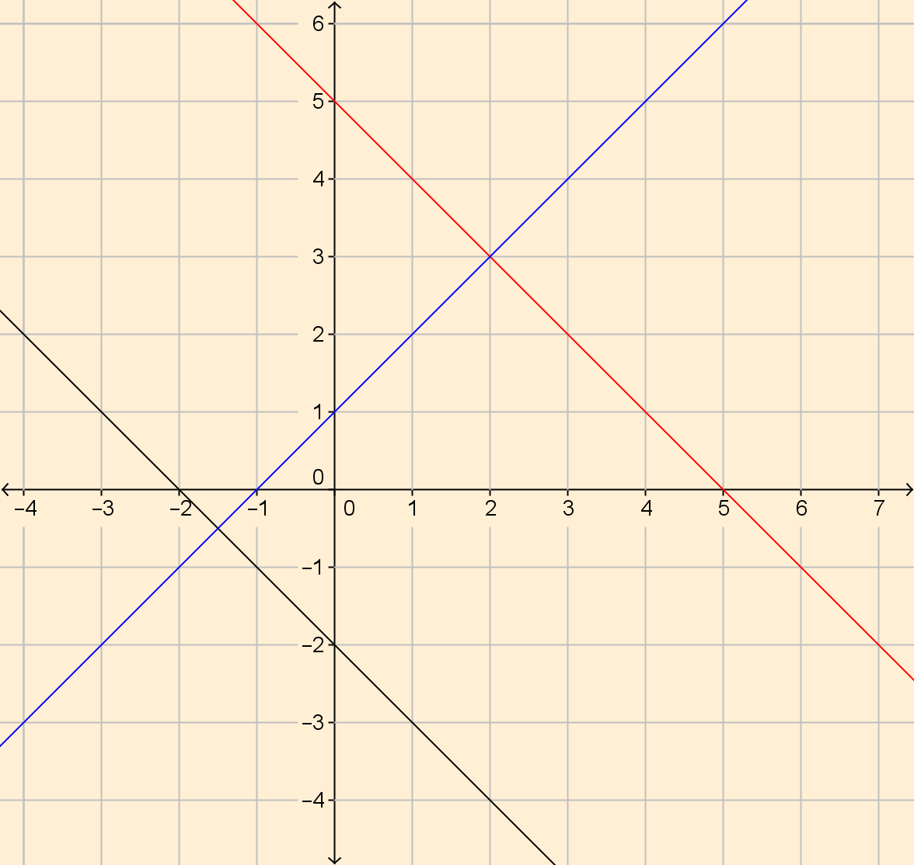
What are the x and y intercepts for the following lines?

Slide 10
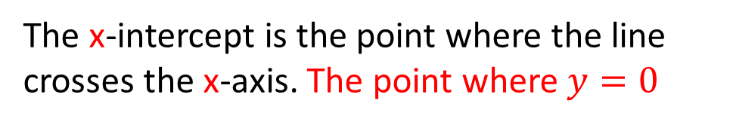
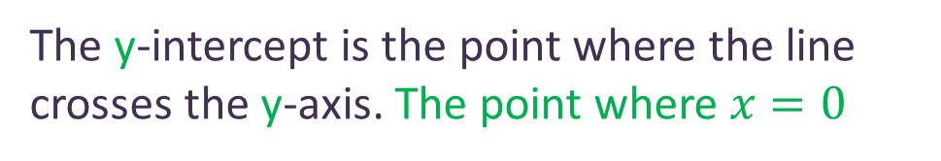
24
7
30
Date
Drawing Linear Graphs 2
EQ – How do you draw a graph using the $x and y$intercepts?
The x-intercept is the point where the line crosses the x-axis. The point where $y=0$
The y-intercept is the point where the line crosses the y-axis. The point where $x=0$
13

Slide 11
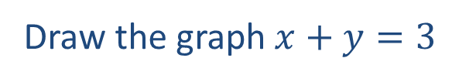
24
7
30
Date
Drawing Linear Graphs 2
EQ – How do you draw a graph using the $x and y$intercepts?
The x-intercept is the point where the line crosses the x-axis. The point where $y=0$
The y-intercept is the point where the line crosses the y-axis. The point where $x=0$
Draw the graph $x+y=3$
13

Slide 12
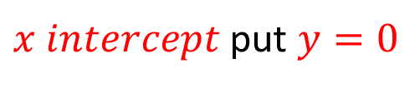
24
7
30
Date
Drawing Linear Graphs 2
EQ – How do you draw a graph using the $x and y$intercepts?
The x-intercept is the point where the line crosses the x-axis. The point where $y=0$
The y-intercept is the point where the line crosses the y-axis. The point where $x=0$
Draw the graph $x+y=3$
$x intercept$ put $y=0$
13

Slide 13
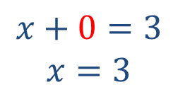
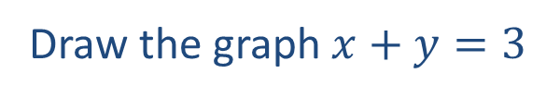
24
7
30
Date
Drawing Linear Graphs 2
EQ – How do you draw a graph using the $x and y$intercepts?
The x-intercept is the point where the line crosses the x-axis. The point where $y=0$
The y-intercept is the point where the line crosses the y-axis. The point where $x=0$
Draw the graph $x+y=3$
$x intercept$ put $y=0$
$$x+0=3$$
$$x=3$$
13

Slide 14
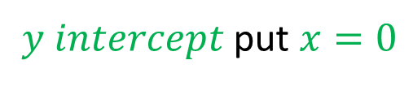
24
7
30
Date
Drawing Linear Graphs 2
EQ – How do you draw a graph using the $x and y$intercepts?
The x-intercept is the point where the line crosses the x-axis. The point where $y=0$
The y-intercept is the point where the line crosses the y-axis. The point where $x=0$
Draw the graph $x+y=3$
$x intercept$ put $y=0$
$$x+0=3$$
$$x=3$$
$y intercept$ put $x=0$
13

Slide 15
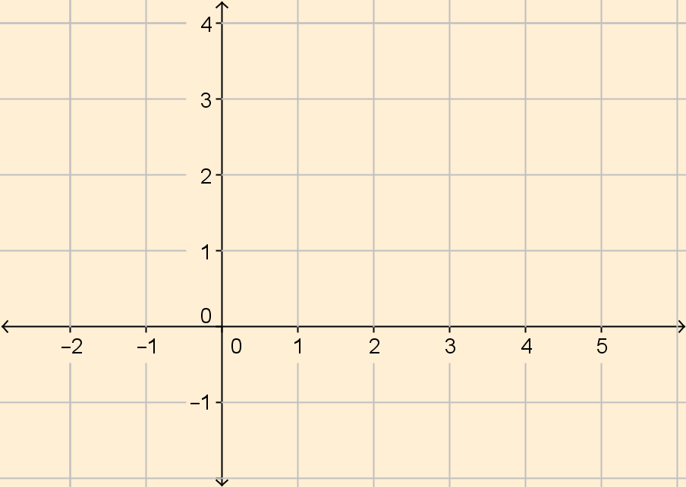
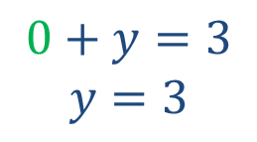
24
7
30
Date
Drawing Linear Graphs 2
EQ – How do you draw a graph using the $x and y$intercepts?
The x-intercept is the point where the line crosses the x-axis. The point where $y=0$
The y-intercept is the point where the line crosses the y-axis. The point where $x=0$
Draw the graph $x+y=3$
$x intercept$ put $y=0$
$$x+0=3$$
$$x=3$$
$y intercept$ put $x=0$
$$0+y=3$$
$$y=3$$
13

Slide 16
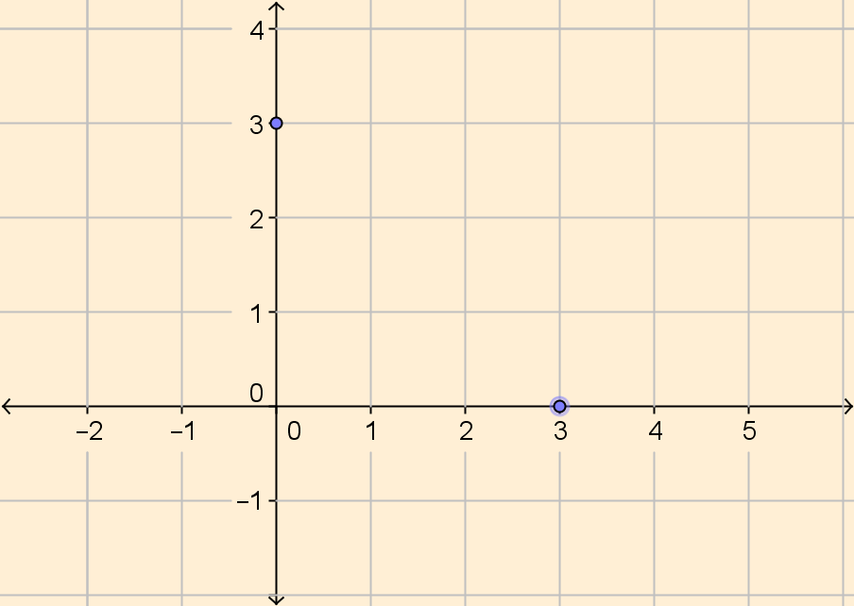
24
7
30
Date
Drawing Linear Graphs 2
EQ – How do you draw a graph using the $x and y$intercepts?
The x-intercept is the point where the line crosses the x-axis. The point where $y=0$
The y-intercept is the point where the line crosses the y-axis. The point where $x=0$
Draw the graph $x+y=3$
$x intercept$ put $y=0$
$$x+0=3$$
$$x=3$$
$y intercept$ put $x=0$
(3.0)
$$0+y=3$$
$$y=3$$
13

Slide 17
24
7
30
Date
Drawing Linear Graphs 2
EQ – How do you draw a graph using the $x and y$intercepts?
The x-intercept is the point where the line crosses the x-axis. The point where $y=0$
The y-intercept is the point where the line crosses the y-axis. The point where $x=0$
Draw the graph $x+y=3$
$x intercept$ put $y=0$
(0.3)
$$x+0=3$$
$$x=3$$
$y intercept$ put $x=0$
(3.0)
$$0+y=3$$
$$y=3$$
13

Slide 18
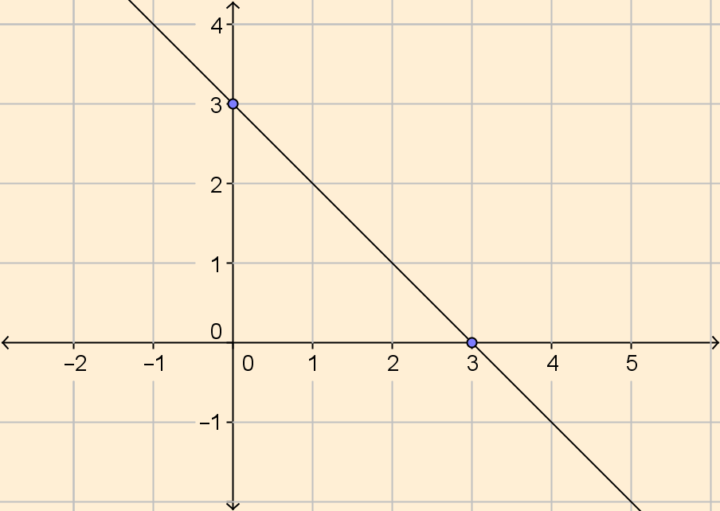
24
7
30
Date
Drawing Linear Graphs 2
EQ – How do you draw a graph using the $x and y$intercepts?
The x-intercept is the point where the line crosses the x-axis. The point where $y=0$
The y-intercept is the point where the line crosses the y-axis. The point where $x=0$
Draw the graph $x+y=3$
$x intercept$ put $y=0$
(0.3)
$$x+0=3$$
$$x=3$$
$y intercept$ put $x=0$
(3.0)
$$0+y=3$$
$$y=3$$
Join the two points
13

Slide 19
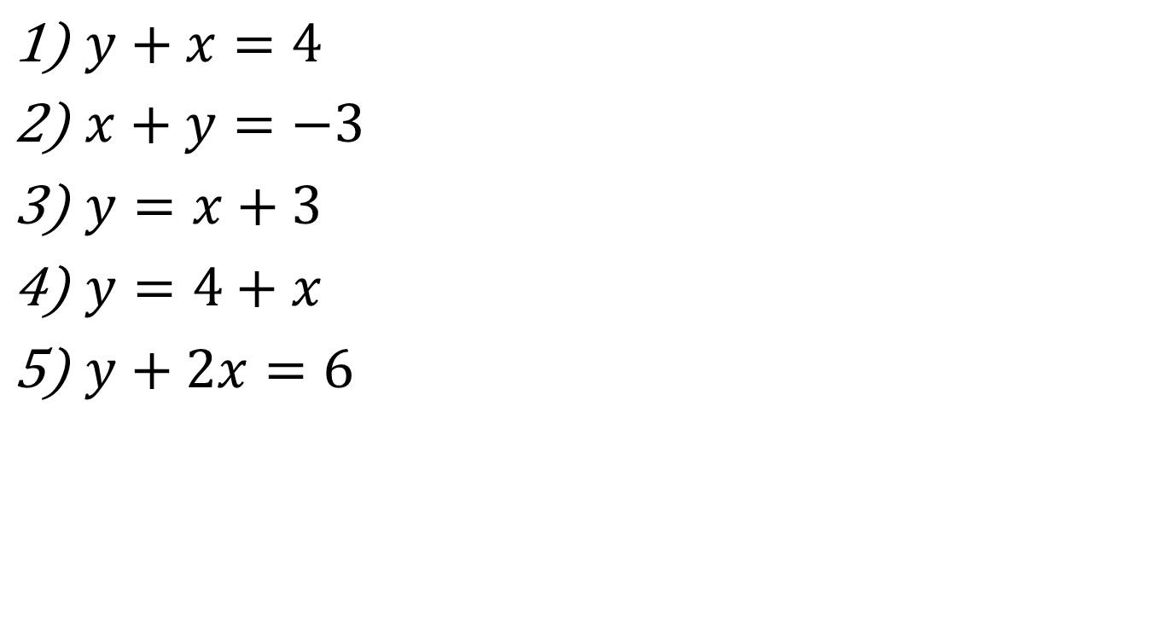
Task – Complete a table and draw the line for the given equation
$y+x=4$
$x+y=−3$
$y=x+3$
$y=4+x$
$y+2x=6$

Slide 20
Questions

Slide 21
Notes Review
24, 7 ,30
Date
Title
Essential question
Notes complete
Notes complete with colour and diagrams
Questions completed
Contents page filed in
Formula page filled in

Slide 22
Homework
Review your notes and write a summary answering the essential question.

